Slide 1

Retail Insights from Superstore Data
-MALLADI NARENDRA

Slide 2

PROBLEM STATEMENT
To analyze superstore data to identify trends, patterns, and insights that can help improve sales strategies, inventory management, and customer satisfaction. The goal is to leverage data analytics to enhance decision-making and drive business growth.

Slide 3
Project Description
To perform a comprehensive analysis of superstore data to uncover trends, patterns, and actionable insights that can enhance sales strategies, inventory management, customer satisfaction, and operational efficiency. The ultimate goal is to leverage these insights to drive business growth and profitability.
The dataset includes transactional data from a superstore, containing the following attributes:
Ship Mode: The mode of shipping (e.g., Standard Class, Second Class, First Class, Same Day).
Segment: Customer segment (e.g., Consumer, Corporate, Home Office).
Country: Country where the order was placed.
City: City where the order was placed.
State: State where the order was placed.
Postal Code: Postal code of the location where the order was placed.
Region: Geographic region where the order was placed (e.g., East, West, Central, South).
Category: Product category (e.g., Furniture, Office Supplies, Technology).
Sub-Category: Product sub-category (e.g., Chairs, Paper, Phones).
Sales: Revenue generated from each order.
Quantity: Number of units sold per order.
Discount: Discount applied to each order.
Profit: Profit generated from each order

Slide 4

WHO ARE THE END USERS?
Business Executives and Managers
Marketing and Sales Teams
Supply Chain and Logistics Teams
Customer Service and Experience Teams
Data Analysts and Data Scientists
Operations and Store Managers

Slide 5

Technology Used
Data Analysis and Visualization:
Python: Programming language used with libraries such as Pandas (data manipulation), NumPy (numerical computing), and SciPy (scientific computing).
Jupyter Notebooks: Interactive computing environments for data analysis, visualization, and machine learning prototyping.
R: Statistical programming language used for data analysis and visualization.
Matplotlib, Seaborn: Python libraries for creating static and interactive visualizations.

Slide 6
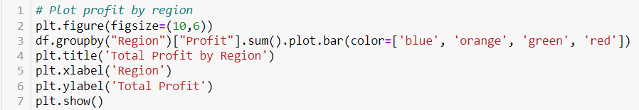
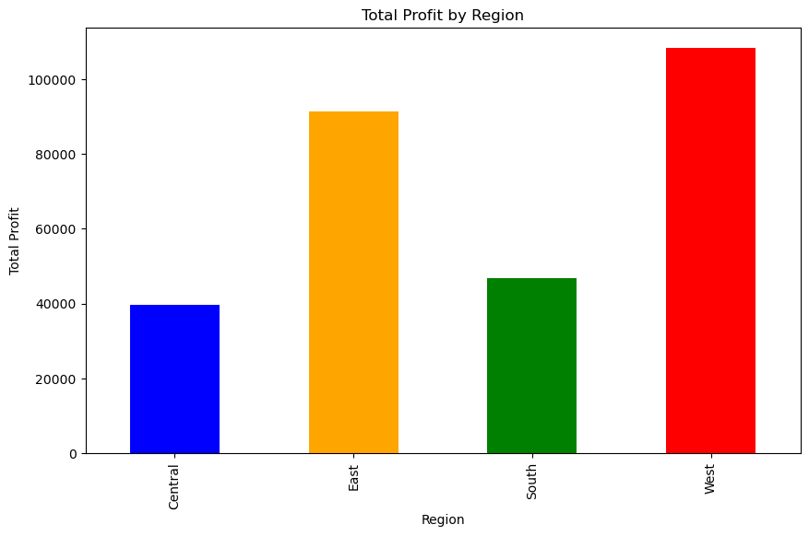
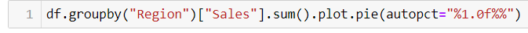
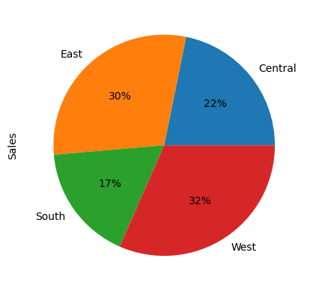
RESULTS
Demo Link

Slide 7
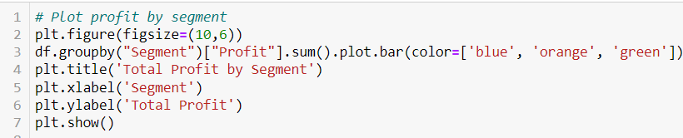
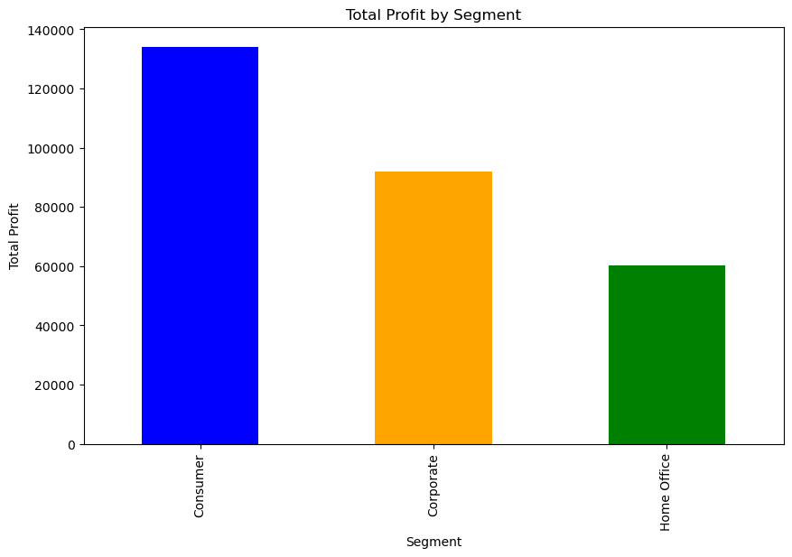
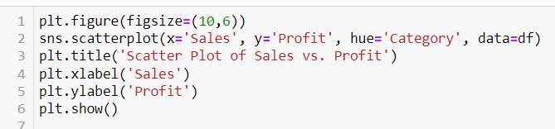
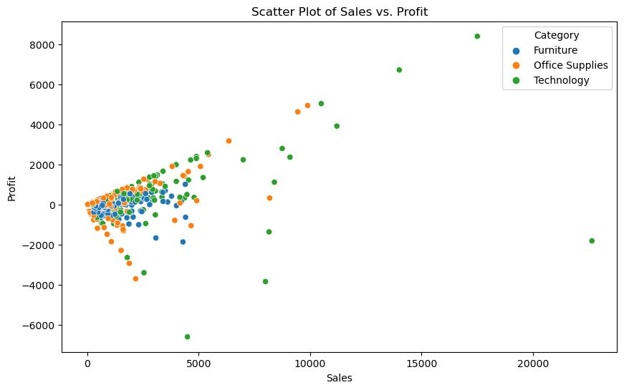

Slide 8
See my repository of my work:
https://github.com/MALLADINARENDRA/EDA-Analysis-on-Superstore-Data

Slide 9

.
.

